Slide 1
Learning Outcomes and Teaching/Learning Quality
Professor Philippos Pouyioutas
Vice Rector
Professor of Computer Science
University of Nicosia
Agricultural University of Athens
Seminar - Accreditation of Programmes in Higher Education
Athens, 9th April 2014

Slide 2







University of Nicosia

Slide 3
Presentation Topics
Aims of the Presentation
Intended Learning Outcomes of the Presentation
European Higher Education Area Reforms
Learning Outcomes
Re-engineering Academic Programmes Using Learning Outcomes
Learning Outcomes and Teaching/Learning Quality
Conclusions

Slide 4
1. Aims of the Presentation

Slide 5
Aims of the Presentation
Explain the European Higher Education Area (EHEA) Reforms
Introduce the concept of Learning Outcomes (LOs) and its relation to EHEA Reforms
Discuss the context/levels of LOs
Explain the relationship between courses and programme LOs
Discuss the LO approach in re-engineering academic programmes with the one currently used at your institution

Slide 6
Aims of the Presentation
Introduce LOs in relation to Academic Evaluation/Accreditation
Discuss the link between LOS and all education stakeholders
Explain the need for engaging social/labour market actors in developing LOs
Highlight the need for developing programmes that meet labour market needs
Explain and discuss how LOs can be used to improve the teaching/learning process

Slide 7
2. Intended Learning Outcomes of the Presentation

Slide 8
Intended LOs of the Presentation
Adopt EHEA Reforms in your university/programmes/courses
Compare and contrast the LO approach in re-engineering academic programmes with the one currently used at your institution
Re-engineer your courses using LOs
Work with colleagues in building a programme’s LOs and ensuring that the supporting courses provide support for the LOs
Provide supporting arguments as to how your courses achieve the programme’s LOs

Slide 9
Intended LOs of the Presentation
Defend your programmes and courses in front of evaluation/audit/accreditation teams
Develop reports that provide evidence for the correct implementation of the LO approach
Strengthen the link between academia and social actors/employers
Engage all stakeholders in developing LOs
Develop programmes that address labour needs
Improve teaching/learning using LOs

Slide 10
3. European Higher Education Area Reforms

Slide 11
European Higher Education Area Reforms (EHEAR)
Empowering the student
Learner (student) – centered learning
  Active student participation in learning process
  Faculty members become educators and facilitators of the learning process and not teachers
Knowledge Triangle – Academia, Research, Business
  partnerships with local industry/business, government and municipality authorities
  applied research for the benefit of the society

Slide 12
European Higher Education Area Reforms (EHEAR)
active involvement of stakeholders (students, alumni, social actors) in designing, delivering and evaluating (including internal and external evaluation) programmes of studies
industry/business-oriented programmes
graduates that meet labour needs
Inclusive/widening access to education
use of ICT in Education – preparing students to become e-citizens
E-learning/Blended Learning modes of delivery – virtual mobility

Slide 13
European Higher Education Area Reforms (EHEAR)
“New” Teaching/Learning methods/approaches – Problem Based Learning, Flip Teaching
Internalization of Universities and cross border education
  Student and Staff Mobility
  Joint/double/multiple degrees
  Project co-operations and strategic partnerships
  Campuses abroad
  Franchised degrees
Transparency/Comparability of Qualifications
Informal and Non-formal Learning
Emphasis on teaching

Slide 14
European Higher Education Area Reforms (EHEAR) Tools
ECTS
DS Label
European Qualifications Framework
National Qualifications Frameworks
U-Multirank
Erasmus +
Standards and Guidelines for Quality Assurance in the European Higher Education Area
Learning Outcomes
http://www.ehea.info/

Slide 15
4. Learning Outcomes and EHEAR

Slide 16
Learning Outcomes
“Learning outcomes describe what a learner is expected to know, understand and be able to do after successful completion of a process of learning.”
“Learning outcomes statements are typically characterised by the use of active verbs expressing knowledge, comprehension, application, analysis, synthesis and evaluation, etc.”

Slide 17
Learning Outcomes
‘Learning Outcomes’ means statements of what a learner knows, understands and is able to do on completion of a learning process, which are defined in terms of knowledge, skills and competence.
‘Knowledge’ means the outcome of the assimilation of information through learning. Knowledge is the body of facts, principles, theories and practices that is related to a field of work or study. In the context of the European Qualifications Framework, knowledge is described as theoretical and/or factual.
‘Skills’ means the ability to apply knowledge and use know-how to complete tasks and solve problems. In the context of the European Qualifications Framework, skills are described as cognitive (involving the use of logical, intuitive and creative thinking) or practical (involving manual dexterity and the use of methods, materials, tools and instruments).
‘Competence’ means the proven ability to use knowledge, skills and personal, social and/or methodological abilities, in work or study situations and in professional and personal development. In the context of the European Qualifications Framework, competence is described in terms of responsibility and autonomy.
http://ec.europa.eu/eqf/terms_en.htm

Slide 18
Writing Learning Outcomes - Verbs
To be Used
  create, plan, revise, analyze, design, select, utilize, apply, demonstrate, prepare, use, compute, discuss, explain, predict, assess, compare, rate, calculate, etc
Not to be used
  know, become aware of, appreciate, learn, understand, become familiar with, etc.

Slide 19
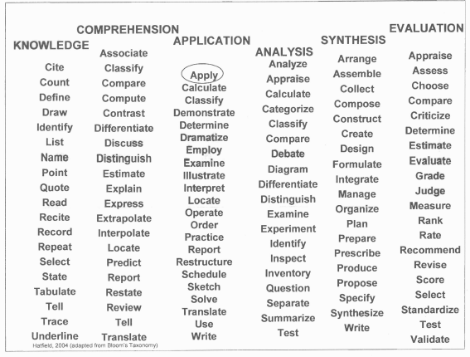
Verbs to be Used

Slide 20
Example- The Objectives of the Course are to:
make students aware of the various database models (emphasis on post-relational models) and database systems
provide students with deep knowledge for developing database applications and fundamental knowledge for developing web-based database applications
cover in detail all aspects of the SQL language (including security, authorization, optimization, embedded SQL)
thoroughly discuss the object-oriented database model, standards and languages and compare this model with the relational model
discuss Data Warehousing, OLAP, Data Mining, Web Technology and XML
introduce state-of-the art research in the area of databases.

Slide 21
Example - After Completing the Course Students are Expected to be Able to:
critically compare and evaluate database models and database systems
design and develop database applications using commercially available database systems
enhance and fine-tune database applications with regards to security, authorization and optimization
develop web-based database applications at an intermediate level
critically assess post-relational database models and especially the object-relational database model, standards and languages
develop advanced queries using the SQL language
research in state-of-the art areas in databases systems.

Slide 22
Another Example ec.europa.eu/eqf/documents?id=99 ‎
Knowledge
On successful completion of the programme the graduate will:
Have detailed knowledge and understanding of a wide range of business disciplines and the manner in which these are combined in the overall process of business management.
Have a good understanding of mathematics, statistics and their applications.
Know-How and Skill
On successful completion of the programme the graduate will:
Be able to analyse business problems and propose solutions.
Be able to confidently engage in and successfully resolve building services engineering projects in both the technical and managerial aspects and be able to communicate effectively their resolution.

Slide 23
Another Example ec.europa.eu/eqf/documents?id=99
Competence
On successful completion of this programme the graduate will:
Have an appreciation of the necessity of national and global sustainable development.
Be able to apply concepts and skills learnt in a variety of contexts.
Be able to research management issues and solutions to issues.
Appreciate the importance of professional development and of the resources available to keep up to date with new developments in business management.
Be able to work independently.
Be able to work effectively in a team.
Be able to take responsibility for his/her own learning.
Be able to learn from experiences gained in different contexts.
Have insights into the dynamics of the management function in the business world.

Slide 24
LOs should be SMART
Specific (clear and unambiguous, clearly communicated to and understood by students)
Measurable (objectively assessed)
Attainable/Achievable (at the right level and possible to be achieved by students)
Realistic/Relevant
Time Specific (possible to be achieved within the timeframe of the programme/course)

Slide 25
LOs at Various Levels
European Qualifications Framework
European Standards in Disciplines/Subject Areas
National Qualifications Framework
Institutional Level (generic)
Programme Level (subject specific)
Course Level
Task Level

Slide 26
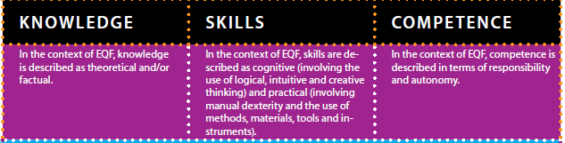
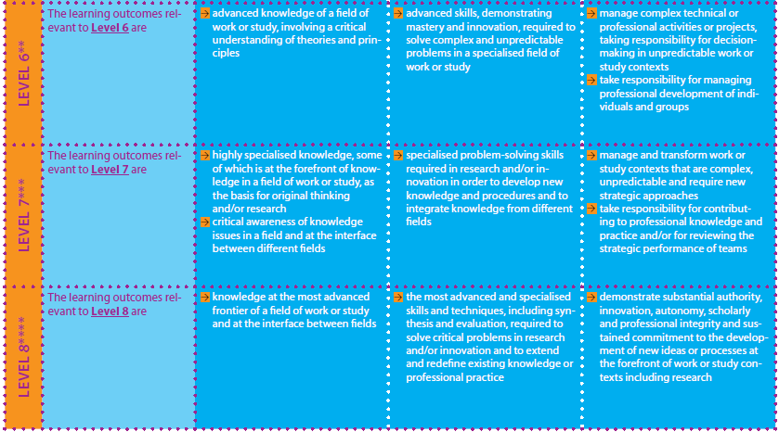
European Qualifications Framework
http://ec.europa.eu/eqf/home_en.htm

Slide 27
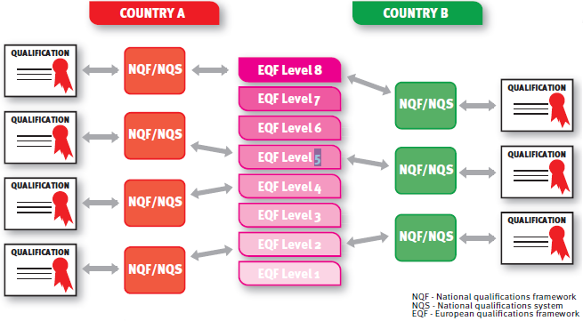
National Qualifications Frameworks
Figure 1 : Mapping NQFs to EQF (adopted from EQF Newsletter April 2010
eac-eqf-newsletter@ec.europa.eu)

Slide 28
LOs and EHEAR
ECTS and LOs
  ECTS Label requires that all programmes and courses are expressed using LOs
  http://www.unic.ac.cy/bachelor-degrees/dance-4-years-bachelor-of-arts/learning-outcomes
  http://www.unic.ac.cy/bachelor-degrees/social-work-4-years-bachelor-of-science-0/learning-outcomes
  http://www.unic.ac.cy/ECTS_Syllabi/COMP-511.pdf
  http://www.unic.ac.cy/ECTS_Syllabi/NUTR-520.pdf
  http://www.hqaa.gr/index.php?option=com_content&view=article&id=154&Itemid=253&lang=en
Diploma Supplement Label and LOs
  section on LOs of the programme
  http://dcbhm58xdznta.cloudfront.net/files/diploma_supplemennt_sample_sep_2013-2.pdf

Slide 29
LOs and EHEAR
European Qualifications Framework
  is defined using LOs
National Qualifications Frameworks
  are defined using LOs
Erasmus+ learning agreements are based on Course LOs
Quality Assurance Agencies require:
  programmes and courses to be expressed using LOs
  LOs to be clearly defined
  LOs to be publically available and known to students
  the involvement of all stakeholders in creating/reviewing LOs

Slide 30
Usefulness of LOs
Provide a common language/platform for transparency, comparability, transferability and recognition of programmes/courses
Students become aware of what they will be able to do after completion of the courses and the programme
Professors are forced to rethink of the curriculum and make sure that each LO is assessed
Employers know what graduates are/should be able to do
Careers Officers can match employers requirements to graduates knowledge, skills and competences (L0s)
Erasmus+ co-ordinators and Academic Departments are facilitated when developing exchange agreements for students and academic staff
Professional Associations can map Programmes to their requirements
Quality Assurance Agencies are facilitated when conducting audits of programmes and when evaluating European awards (through the EQF-NQF mapping)
Enforce Accountability

Slide 31
Quality Assurance Agencies and LOs
QAA are in the process of modifying their accreditation/validation rules and procedures to incorporate L0s. QAA audits look for evidence that
  all stakeholders were involved in the formulation of a programme’s LOs
  there is consistency of LOs according to their level (e.g. 1st Cycle LOs match EQF and NQF corresponding level)
  there is consistency of a programme’s LOs with the LOs specified in European Standards/Sector frameworks, benchmarks, etc.)
  a programme’s LOs comply with technical qualifications frameworks at National Level
  there is consistency and comparability among LOs across the institution and its programmes
  the institution provides all resources so that LOs are SMART, are assessed and are met by students

Slide 32
Accreditation in Lithuania
Evaluation area | Points
Programme aims and learning outcomes | 1-4
Curriculum design | 1-4
Teaching staff | 1-4
Facilities and learning resources | 1-4
Study process and student assessment | 1-4
Programme management | 1-4
TOTAL | 6-24

Slide 33
Accreditation in Lithuania
Programme aims and learning outcomes
  The programme aims and learning outcomes are well defined, clear and publicly accessible
  the programme aims and learning outcomes are based on the academic and/or professional requirements, public needs and the needs of the labour market
  the programme aims and learning outcomes are consistent with the type and level of studies and the level of qualifications offered
  the name of the programme, its learning outcomes, content and the qualifications offered are compatible with each other.

Slide 34
Accreditation in Lithuania
Curriculum Design
  the curriculum design meets legal requirements
  study subjects and/or modules are spread evenly, their themes are not repetitive
  the content of the subjects and/or modules is consistent with the type and level of the studies
  the content and methods of the subjects/modules are appropriate for the achievement of the intended learning outcomes
  the scope of the programme is sufficient to ensure learning outcomes
  the content of the programme reflects the latest achievements in science, art and technologies.

Slide 35
Accreditation in Lithuania
If (total number of points >= 18) and
(each evaluation area >= 3) then
6 years Accreditation
else if
(total number of points >= 12) and
(each evaluation area is >= 2) then
3 years Accreditation
else
no accreditation;
if 3 years accreditation in year X and
3 years accreditation in year X+3 and not
6 years accreditation in year X+6 then
no accreditation.

Slide 36
Trends in European Higher Education 2015 EUA Survey
Expected Benefits of LOs
  Revision of Course Content
  Change of Teaching/Learning Methods
  Improved co-operation among teaching staff
  Improvement of teaching quality
  Revision of examinations and assessment methods
  Improvement of transfer/recognition of credits
  Easier recognition of prior learning
  Increased awareness of students with regards their learning objectives
  Improvement of student pass grades

Slide 37
5. Re-engineering Academic Programmes Using Learning Outcomes

Slide 38
What is Re-engineering in terms of Business Information Systems?
Rethinking of the Business Processes
Not automating existing processes
Redesigning Business Processes
Restructuring the organization
Automating the newly designed processes

Slide 39
What is Re-engineering in terms of academic programmes?
Rethinking of the academic programmes
Redesigning the academic programmes
Restructuring the academic programmes

Slide 40
Academic Programme
Programme Structure (thematic areas and clusters of courses, core, elective, etc. courses, pre-requisites, co-requisites, semester breakdown, etc.)
Programme and Course Content
  Aims and Objectives usually expressed from the programme/course point of view and referring to knowledge and skills to be given to /cultivated in students
  Topic areas and description of material to be covered
Delivery Methods
  Teaching and Learning
  Resources (Labs, Books, etc.)
  Assessment

Slide 41
LOs and Re-engineering of Academic Programmes
LOs force you to re-think carefully the content of the programme from the point of view of the student (Learning Outcomes (LOs) vs. Aims and Objectives)
LOs forces you to re-think carefully the delivery methods of the programme/courses (Teaching and Learning and Assessment of Learning Outcomes)

Slide 42

 | PLANNING FORM FOR AN EDUCATIONAL MODULE - University of Nicosia (to be completed by the teacher)
Learning outcomes By the end of this course a student is expected to: | Educational activities | Assessment | Estimated student work time in hours
critically compare and evaluate database models and database systems | Lectures, project 1 | Project, 1 Final Exam | 20
design and develop database applications using commercially available database systems | Lectures, problem-solving sessions, laboratory sessions, project 2 | Project 2 | 40
enhance database applications with regards to security, authorization and optimization | Lectures, laboratory sessions, homework | Final Exam | 20
develop web-based database applications at an intermediate level | Lectures, laboratory sessions, project 2 | Project 2 | 10

Slide 43
 | PLANNING FORM FOR AN EDUCATIONAL MODULE - University of Nicosia (to be completed by the teacher)
Learning outcomes | Educational activities | Assessment | Estimated student work time in hours
critically assess post-relational database models and especially the object-relational database model, standards and languages | Lectures, project 1 | Project 1, Final Exam | 35
develop advanced queries using the SQL language | Lectures, laboratory sessions, homework, project 2 | Project 2, Final Exam | 20
research in state-of-the art areas in databases systems | Lectures | Final Exam | 15
 |  |  | 160

Slide 44
Programme LOs vs Course LOs
A programme consists of many courses
A Programme has a number of programme LOs (PLOs)
A Course has a number of course LOs (CLOs)
A PLO must be supported by at least one course
A course can support many PLOs

Slide 45
Programme LOs vs. Courses

Slide 46
6. Teaching/Learning Quality and LOs

Slide 47
The Importance of Teaching
Teaching quality is becoming a strategic direction of the EHEA reforms.
Its importance is recently gaining more and more recognition by both the policy makers as well as the various providers of higher education.
The vision and mission of Universities, even of those universities who have been traditionally focused mainly on basic research address now a more balanced provision of teaching and research.

Slide 48
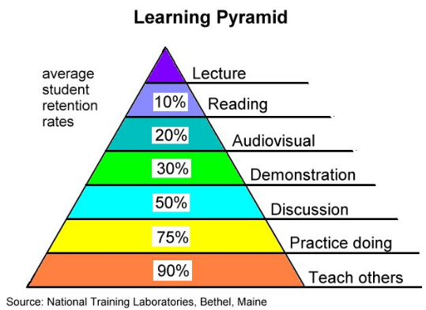
Teaching/Learning

Slide 49

EC Report “Improving the quality of teaching and learning in Europe’s higher education institutions”
http://ec.europa.eu/education/higher-education/doc/modernisation_en.pdf

Slide 50
EC Report “Improving the quality of teaching and learning in Europe’s higher education institutions”
teaching and learning are fundamental core missions of universities and colleges
active student involvement is essential in governance, curricular design, development and review, quality assurance and review procedures
preference of research over teaching in defining academic merit needs rebalancing
academic staff are employed not just to teach, but to teach well, to a high professional standard
http://ec.europa.eu/education/higher-education/doc/modernisation_en.pdf

Slide 51
EC Report “Improving the quality of teaching and learning in Europe’s higher education institutions”
a key responsibility of institutions to ensure their academic staff are well trained and qualified as professional teachers not just qualified in a particular academic subject; this responsibility extends to
  ensuring new staff have a teaching qualification or equivalent on entry or have access to credible teacher training courses in the early years of their career
  providing opportunities for continuous professional career development as a professional teacher and not just as a subject/discipline specific academic;
it is a key responsibility of academic staff to ensure they are qualified to teach and able to teach well; this responsibility extends over their entire career from start to finish so that they remain up-to-date and proficient in the very best pedagogical practices and all that quality.
http://ec.europa.eu/education/higher-education/doc/modernisation_en.pdf

Slide 52
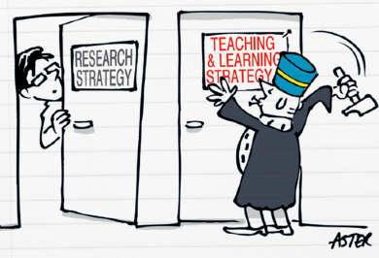

Recommendation 2 - Every institution should develop and implement a strategy for the support and on-going improvement of the quality of teaching and learning, devoting the necessary level of human and financial resources to the task, and integrating this priority in its overall mission, giving teaching due parity with research.
http://ec.europa.eu/education/higher-education/doc/modernisation_en.pdf

Slide 53


Recommendation 3 - Higher education institutions should encourage, welcome, and take account of student feedback which could detect problems in the teaching and learning environment early on and lead to faster, more effective improvements.
http://ec.europa.eu/education/higher-education/doc/modernisation_en.pdf

Slide 54
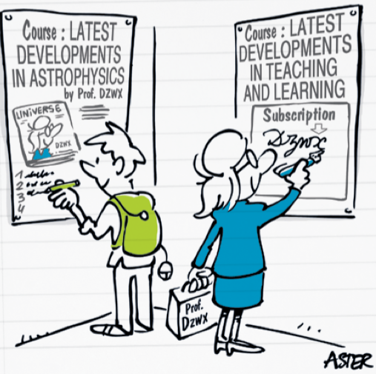

Recommendation 4 - All staff teaching in higher education institutions in 2020 should have received certified pedagogical training. Continuous professional education as teachers should become a requirement for teachers in the higher education sector.
http://ec.europa.eu/education/higher-education/doc/modernisation_en.pdf

Slide 55


Recommendation 5 - Academic staff entrance, progression and promotion decisions should take account of an assessment of teaching performance alongside other factors.
http://ec.europa.eu/education/higher-education/doc/modernisation_en.pdf

Slide 56


Recommendation 6 - Heads of institutions and institutional leaders should recognise and reward (e.g. through fellowships or awards) higher education teachers who make a significant contribution to improving the quality of teaching and learning, whether through their practice, or through their research into teaching and learning.
http://ec.europa.eu/education/higher-education/doc/modernisation_en.pdf

Slide 57


Recommendation 7 - Curricula should be developed and monitored through dialogue and partnerships among teaching staff, students, graduates and labour market actors, drawing on new methods of teaching and learning, so that students acquire relevant skills that enhance their employability.
http://ec.europa.eu/education/higher-education/doc/modernisation_en.pdf

Slide 58
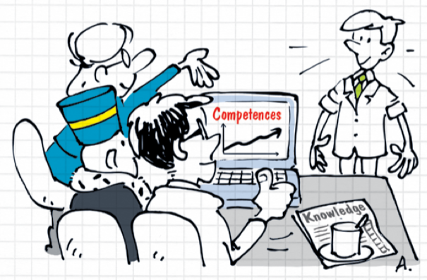

Recommendation 8 - Student performance in learning activities should be assessed against clear and agreed learning outcomes, developed in partnership by all faculty members involved in their delivery.
http://ec.europa.eu/education/higher-education/doc/modernisation_en.pdf

Slide 59


Recommendation 9 - Higher education institutions and national policy makers in partnership with students should establish counselling, guidance, mentoring and tracking systems to support students into higher education, and on their way to graduation and beyond.
http://ec.europa.eu/education/higher-education/doc/modernisation_en.pdf

Slide 60
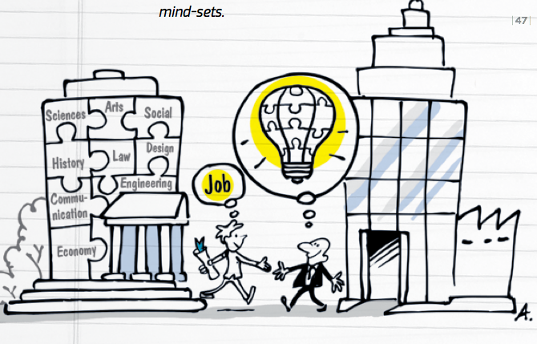

Recommendation 10 - Higher education institutions should introduce and promote cross-,trans- and interdisciplinary approaches to teaching, learning and assessment, helping students develop their breadth of understanding and entrepreneurial and innovative mind-sets.
http://ec.europa.eu/education/higher-education/doc/modernisation_en.pdf

Slide 61


Recommendation 11 - Higher education institutions – facilitated by public administrations and the EU – should support their teachers so they develop the skills for online and other forms of teaching and learning opened up by the digital era, and should exploit the opportunities presented by technology to improve the quality of teaching and learning.
http://ec.europa.eu/education/higher-education/doc/modernisation_en.pdf

Slide 62


Recommendation 12 - Higher education institutions should develop and implement holistic internationalisation strategies as an integral part of their overall mission and functions. Increased mobility of student and staff, international dimension of curricula, international experience of faculty, with a sufficient command of English and a second foreign language and intercultural competences, transnational delivery of courses and degrees, and international alliances should become indispensable components of higher education in Europe and beyond.
http://ec.europa.eu/education/higher-education/doc/modernisation_en.pdf

Slide 63
The Teaching in Higher Education Quality Model (THEQM)
A Model based on the EC Report
THEQM calculates for each institution an overall score (0 to 100) and a score within each recommendation (0 to 9).
There are eleven (11) recommendations and each recommendation has nine (9) indicators.
Each index is either satisfied (in which case a score of one (1) is given) or not satisfied (in which case a score of zero(0) is given).
Thus ninety-nine (99) indicators are provided giving a maximum 99 points if all are satisfied.
Another point is given by satisfying the following Overall Quality Indicator. The institution does not consider any other activity more important than teaching.
Thus a maximum of one hundred (100) points can be achieved. An institution can thus achieve an overall score as well as eleven (11) other scores, one (1) for each recommendation.

Slide 64
Recommendation 8 Student performance in learning activities should be assessed against clear and agreed learning outcomes, developed in partnership by all faculty members involved in their delivery
The institution regulations provide for a methodology and a process for designing/evaluating the curriculum using Learning Outcomes.
The institution’s regulations ensure that Programme and Course Learning Outcomes are built with input from all stakeholders (teachers, students, labour market actors).
The institution’s regulations ensure that a process/mechanism exists for checking whether Programme Learning Outcomes can be achieved though the programme’s courses.
The institution’s regulations ensure that Learning Outcomes are SMART (Specific, Measurable, Achievable, Realistic, Time-Specific).
The institution’s regulations provide for checking the Learning Outcomes against the student workload as estimated/provided/calculated by the students.
Each Learning Outcome at the Programme and Course level is associated with learning methods and assessment methods and is allocated a specific workload.
Learning Outcomes are associated with knowledge, skills and competences.
The assessment of Learning Outcomes focuses on the assessment of competences.
The institution’s regulations provide for a feedback process/mechanism for reviewing Learning Outcomes and their assessment.

Slide 65
LOs and Teaching/Learning Quality
Developed/reviewed using input from all stakeholders
Programme LOs (PLOs) in line with name of programme and curriculum design
PLOs are checked whether they are met by courses
Re-thinking of the curriculum (shifting from aims and objectives to LOs)
Re-thinking of learning/assessment methods
Estimating student workload for achieving LOs
Soliciting student feedback for LOs workload

Slide 66
7. Conclusions

Slide 67
Conclusions
There are some different definitions in the literature with regards to LOs
There is ignorance and confusion amongst the various stakeholders with regards to LOs
LOs at are still being implemented at various levels (NQF, Universities, QAA)
Educational models and University and QAA rules/regulations/procedures are being re-engineered using LOs
Re-engineering academic programmes using LOs provides a great opportunity to improve the programme, the delivery and assessment methods and the student learning process
LOs benefit all stakeholders and contribute to the mobility of students/graduates/faculty/employees within Europe

Slide 68
My Applied Research in EHEAR
ReProTool– funded by the Cyprus Research Promotion Foundation
  Software tool supporting the use of LOs
MapQFTool
  Software tool supporting the mapping of National Qualification Frameworks to the European Qualifications Framework and thus the mapping between the qualifications of various EU countries
THEQMTool
  Software tool supporting the Teaching in Higher Education Quality Model
  Papers available at
  http://unic.academia.edu/PhilipposPouyioutas

Slide 69
Thank you!
Questions?
pouyioutas.p@unic.ac.cy
http://unic.academia.edu/PhilipposPouyioutas

